Slide 1
COMP 2310 Data Structures and Algorithms
Lecture 7
Tree Structures – Part 1

Slide 2
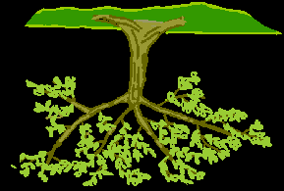
Tree Structures – Part 1:
Basic Terminology, Binary Trees, Traversals
Trees in computer science grow upside-down

Slide 3
Non-Linear Data Structures
Arrays and linked lists are linear structures.
Linked lists usually provide greater flexibility than arrays.
However, since the nodes are in logical linear order, it is difficult to use them to represent objecs that are in some non-linear order.
To overcome this difficulty we need non-linear data structures.
Major types are: trees and graphs.
In this category, first we are going to study tree structures.
Notes:
3

Slide 4
Tree Structures
Trees are one of the most powerful and common data structures which have numerous applications in science and engineering .
“Trees sprout up just about everywhere in computer science…”
— Donald Knuth

Slide 5
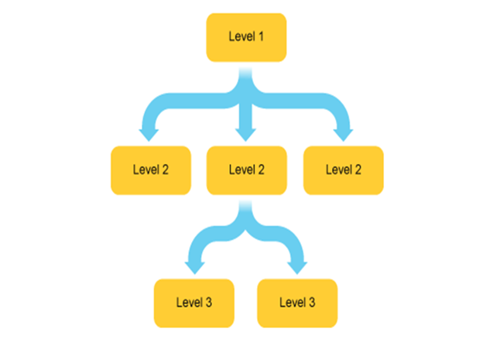
Tree Structures
A tree imposes a hierarchical structure on a list of items.
(Hierarchical: Organized according to rank or authority.)
Some application areas:
Representing mathematical expressions.
Representing structure of source programs in compilers.
File systems
Programming environments
Analyzing electrical circuits
Representing organizations
…………………………………….
Notes:
5

Slide 6
Basic terminology: Tree Nodes
A tree is a collection of elements called nodes.
One of the nodes is distinguished as the root which is placed at the top of the tree.
The nodes at the bottom of the tree are called leaves, all the others are internal nodes.
A tree consists of a root, and empty or nonempty subtrees each of whose roots are connected to the root by a branch (edge).
Notes:
6

Slide 7
Examples of Trees
(a) An empty tree
(b)
(c)
(d)
(e)
(f)
Notes:
7

Slide 8
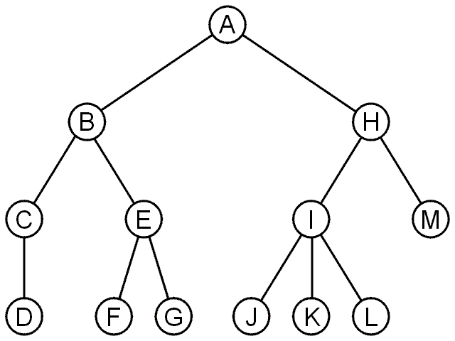
Rooted Tree: Example
A rooted tree data structure stores information in nodes.
Similar to linked lists:
There is a first node, or root
Each node has variable number of references to successors
Each node, other than the root, has exactly one node pointing to it.

Slide 9
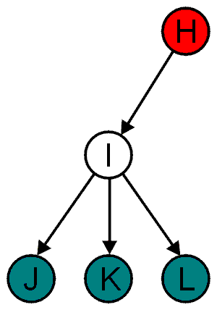
Basic Terminology
All nodes will have zero or more child nodes or children
I has three children: J, K and L
For all nodes other than the root node, there is one parent node
H is the parent I
Nodes with the same parent are siblings
J, K, and L are siblings
The degree of a node is defined as the number of its children:
deg(I) = 3

Slide 10
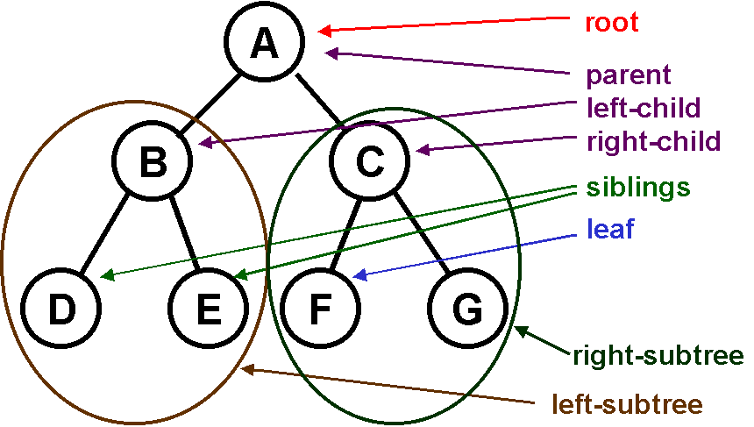
Basic terminology: Node Relationships
Note that tree is a recursive structure: Every subtree is also a tree → A tree is composed of trees!

Slide 11
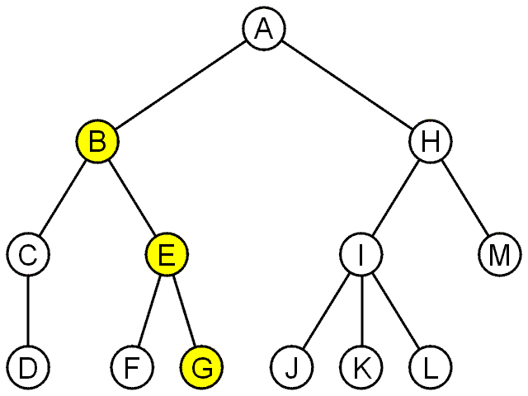
Basic terminology: Path
For each node in a tree, there exists a unique path from the root to that node.
A path is a sequence of nodes
(a₀, a₁, ..., a_{n})
where a_{k + 1} is a child of a_{k}
The length of this path is n
Ex: the path (B, E, G) has length 2
The length of path (A,H,I,L)
is 3.

Slide 12
Basic terminology: Depth and Height
The depth of a node X is the length of the path from the root to this node.
The height of a node X is the length of the longest path from this node to a leaf.
The height of all leaves is 0.
The height of a tree is equal to the height of the root.
If there is a path from X to Y and height of X is greather than height of Y then X is an ancestor of Y and Y is descendant of X.
Notes:
12

Slide 13
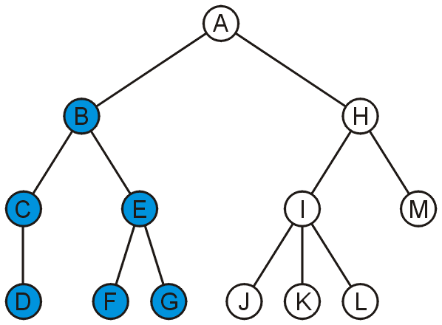
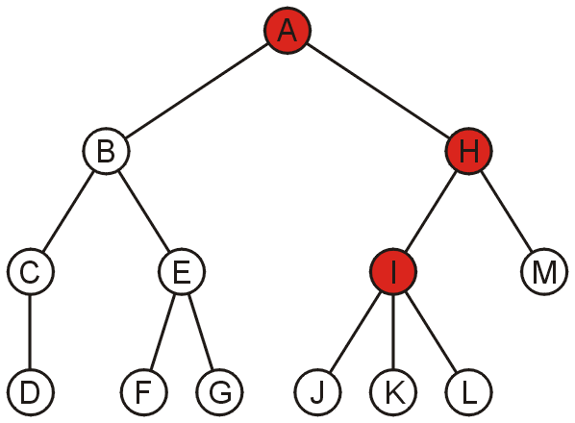
Basic Terminology: Descendent / Ancestor
The descendants of node B are C, D, E, F, and G:
The ancestors of node I are H, and A:

Slide 14
Basic terminology: Example
A is the root
A
Node D is an ancestor of node N
Node N is an descendant of node D
B
C
D
E
F
H is the left child of D
I is the right child of D
G
H
I
J
K
L
M
H is the parent of N and O
Depth of node D is 1
Height of node D is 2
The degree of E is 3
Depth of node A is 0
Height of node A is 3
Height of the tree is 3
N
O
Notes:
14

Slide 15
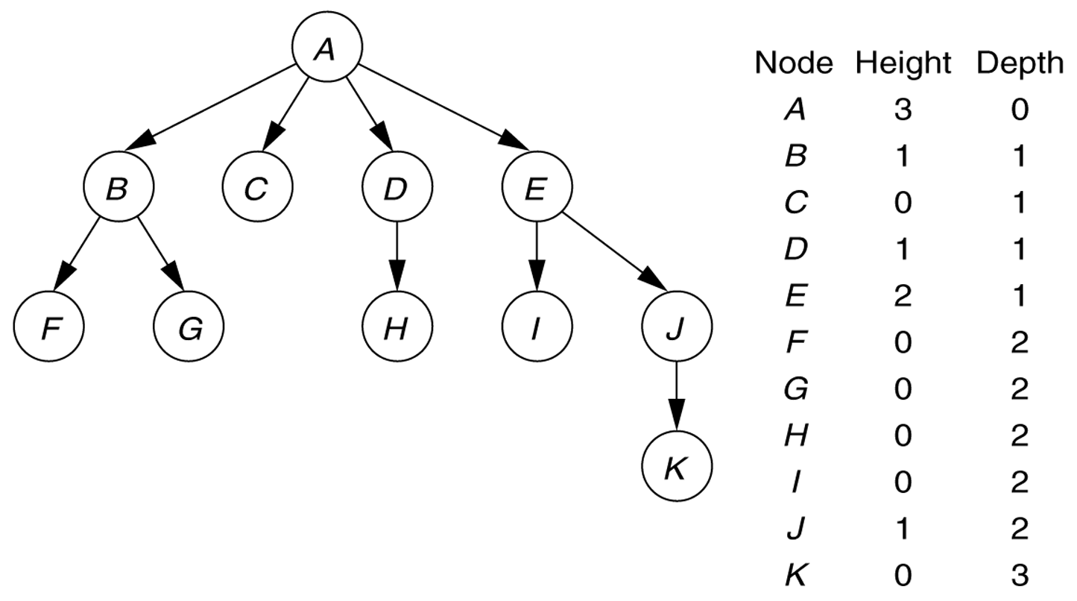
A tree, with height and depth information

Slide 16
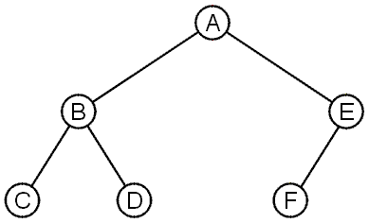
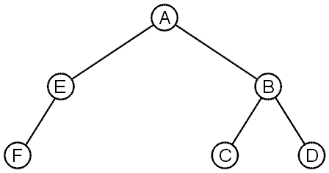
Ordered / Unordered Trees
These trees are equal if the order of the children is ignored
unordered trees
They are different if order is relevant: ordered trees
We will usually examine ordered trees.

Slide 17
Tree Properties: Find Operations
Property Value
Number of nodes
Root Node
Leaves
Interior nodes
Ancestors of H
Descendants of B
Siblings of E
Right subtree of A
Depth of E
Hight of the tree
A
B
C
D
E
F
G
H
I

Slide 18
Problems of Using General Trees
The arbitrary number of children in general trees is often unnecessary - many real-life trees are restricted to two branches:
Computer operations and logic
Expression trees and binary operators
Ancestral trees of an individual; parents, grandparents, etc.
Encoding algorithms
……………………….
How to reduce the complexity of the required tree operations?
Answer: Use binary trees.

Slide 19
Binary Trees
If the maximum number of children in any node is m, the tree is called an m-ary tree.
→ A binary tree is a 2-ary tree
Binary tree nodes have at most two children:
→ Zero or 1 or 2 children.
A child is specified to be either left or right child of a parent.
The children of a node is an ordered pair.
→ Binary trees are ordered trees.
It can be proven algebraically that :
“Any general tree can be converted to an equivalent binary tree“
Notes:
19

Slide 20
Examples of Binary Trees
Binary trees are “ordered” trees: The position of each node and branch is fixed as left or right.
Different binary trees
Notes:
20

Slide 21
Complete Binary Trees
A complete binary tree has a restricted shape obtained by starting at the root and filling the tree levels from left to right.
All the levels are full, except possibly the rightmost positions of the last level.
t
A complete binary tree
Notes:
21

Slide 22
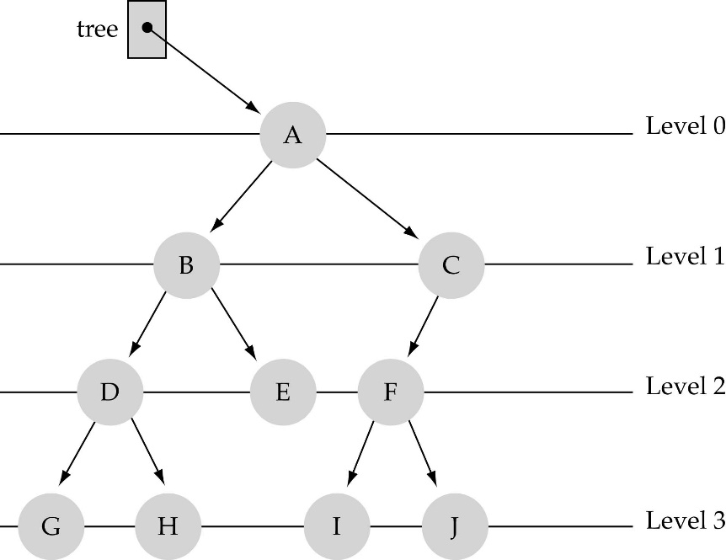
Level and Height
Nodes are organize in levels (indexed from 0).
Level (or depth) of a node: number of branches in the path from the root to that node.
Height of a tree h: #levels = L
(Warning: some books define h
as #levels-1).
Full tree: every node has either 0 or 2 children.
Not full, not complete

Slide 23
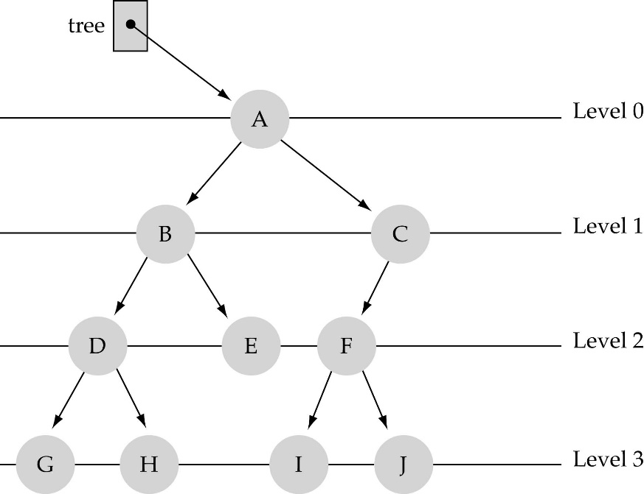
What is the #nodes at some level l?
#nodes at level l ≤ 2^{l}

Slide 24
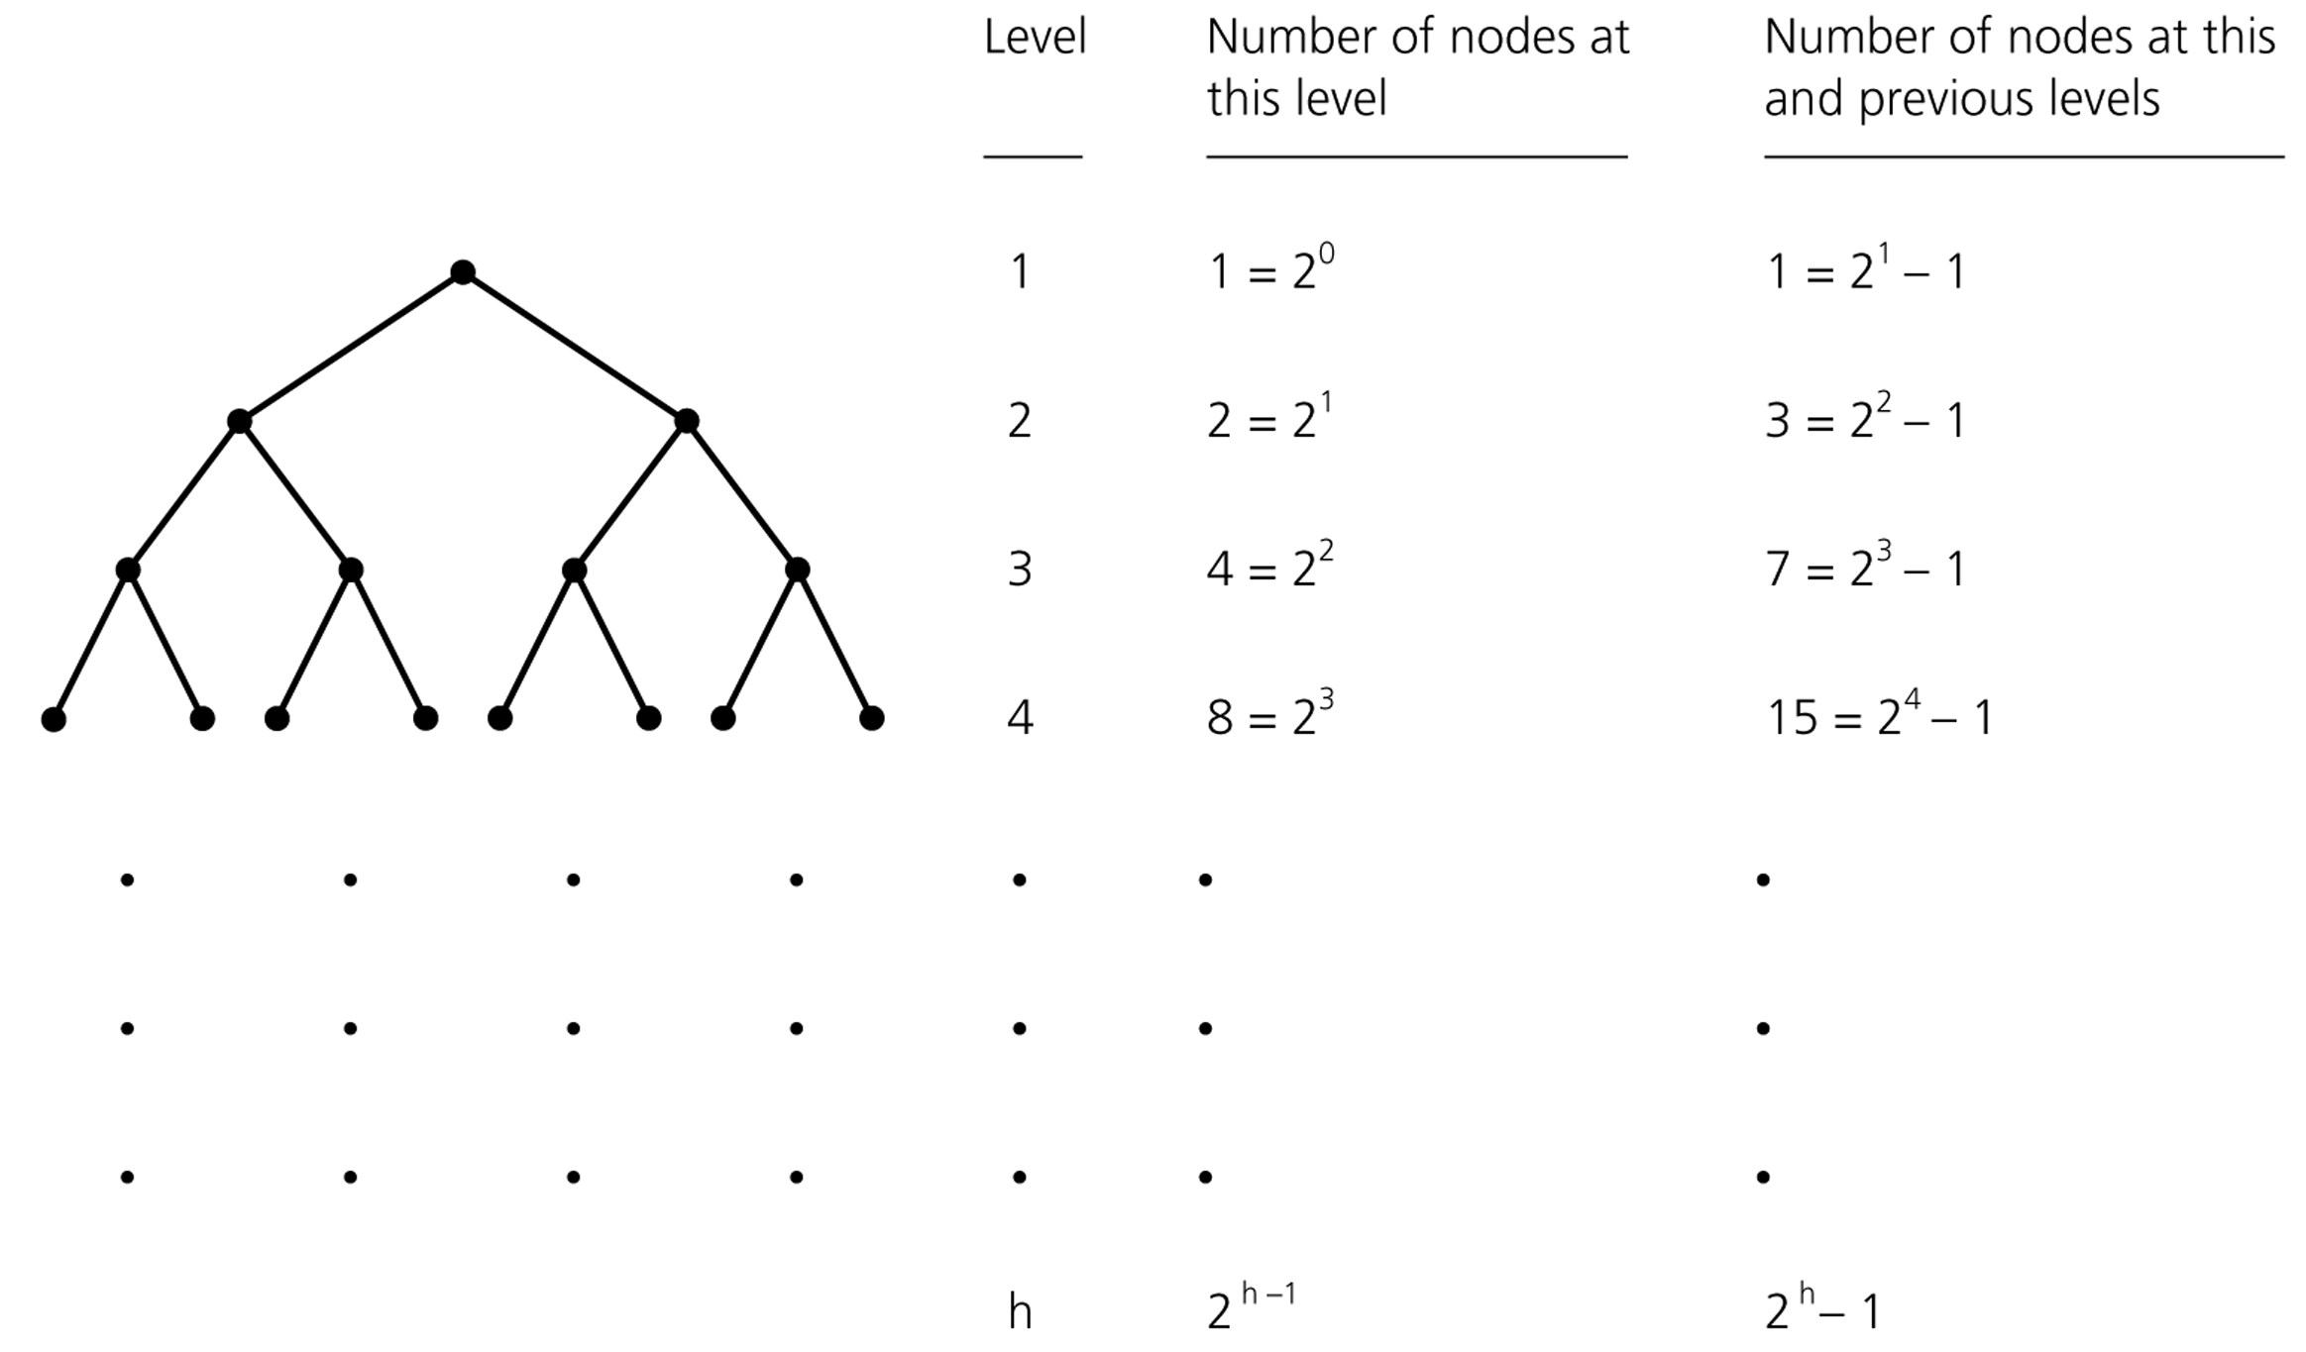
Node Counts in a Full Binary Tree of Height h
0
1
2
3
+1

Slide 25
Total max #nodes of a full tree with height h-1
This is a geometric series with term h.
take x=2 and n=h:
l=0
l=1
l=h-1
Example : h=2, N= 2³-1=7

Slide 26
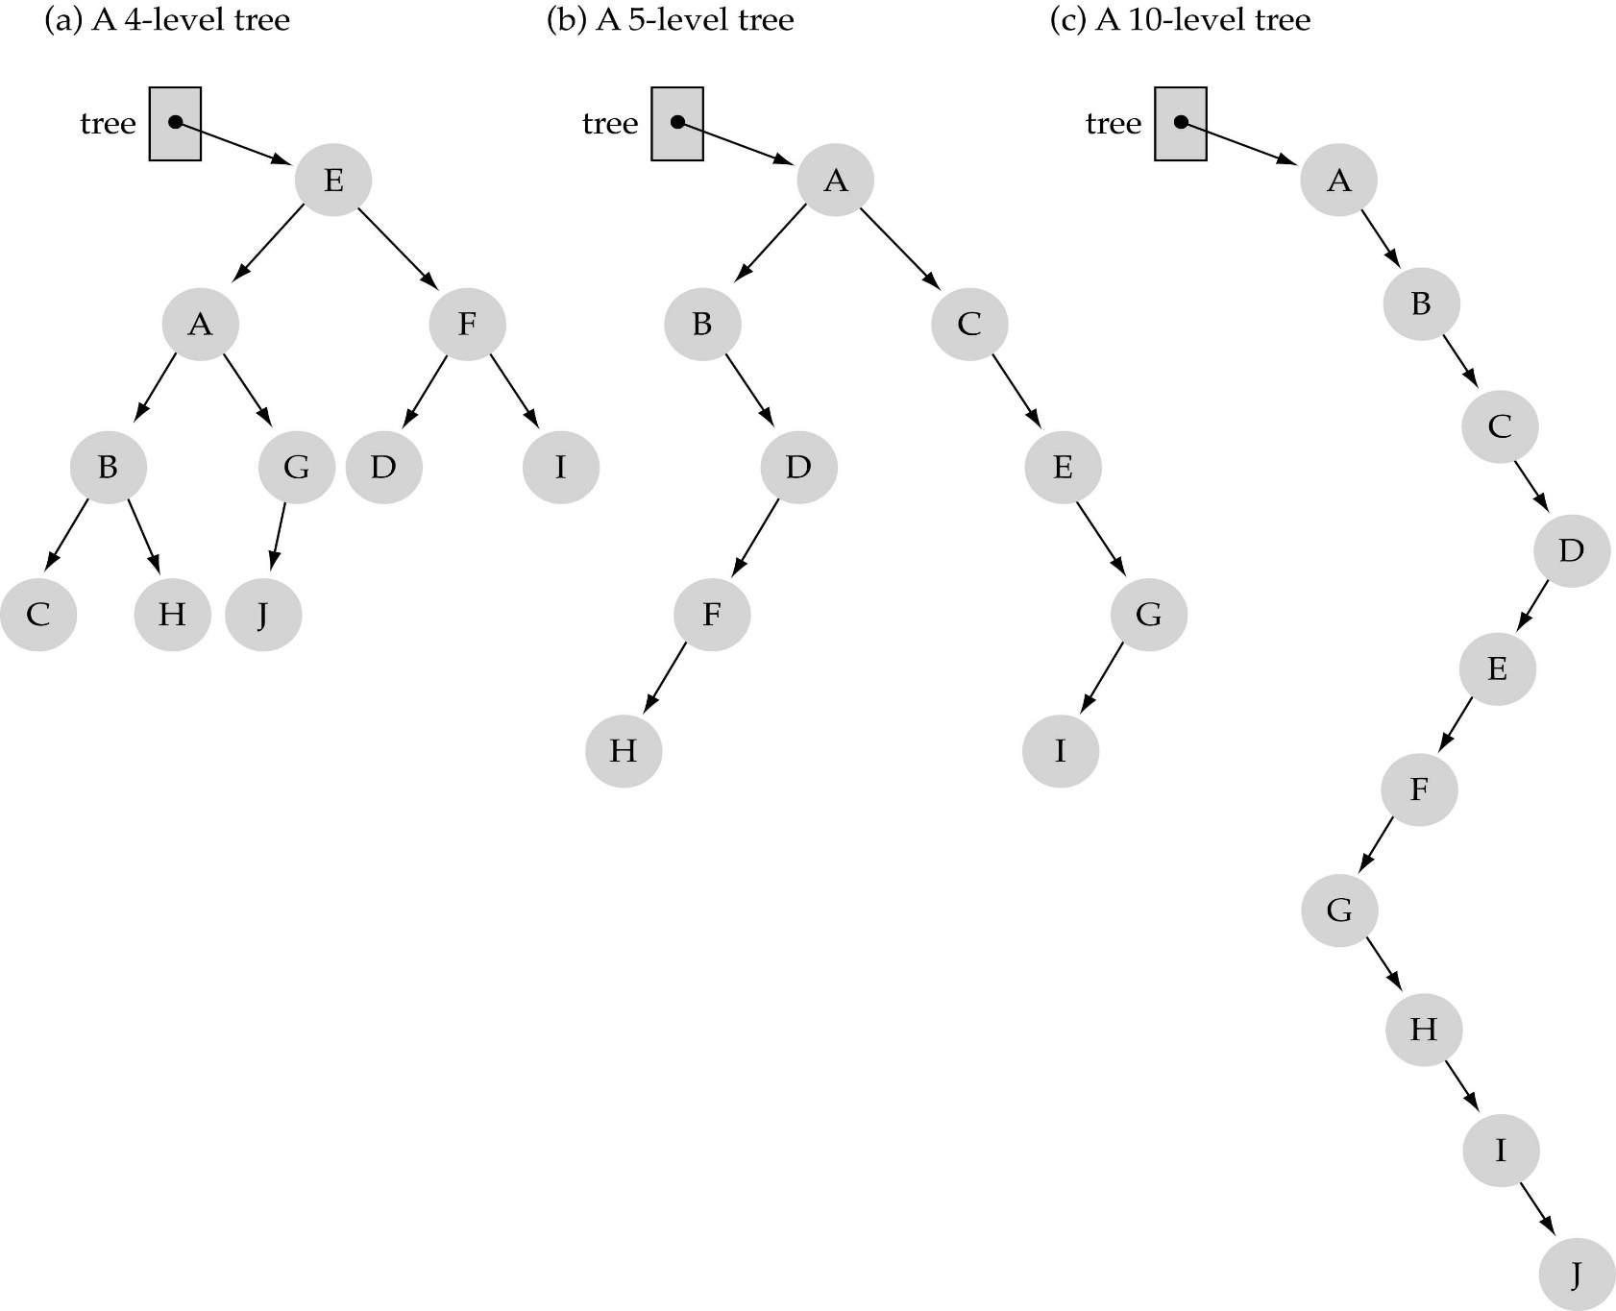
Example: What are max total #nodes?

Slide 27
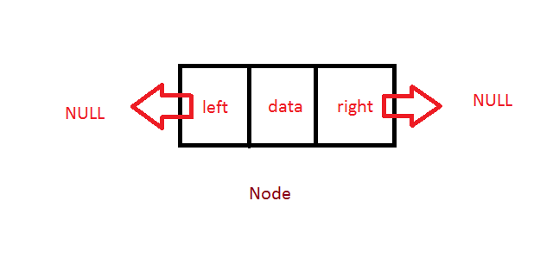
Binary Tree Node Structure
Each node of a binary tree contains:
Data
A reference or pointer to a left child (may be null)
A reference or pointer to a right child (may be null)

Slide 28
Implementation of Binary Trees
Since a binary tree has at most two children we can establish direct links to them.
struct BinaryNode
{
int data; //Data in the node
BinaryNode *left; //Left ptr
BinaryNode *right;//Right ptr
};
Notes:
28

Slide 29
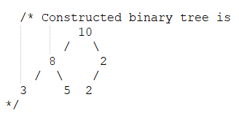
Implementation of Binary Trees
struct node {
int data;
struct node* left;
struct node* right;
};
struct node* newNode(int data)
{
struct node* node = new struct node;
node->data = data;
node->left = NULL;
node->right = NULL;
return (node);
}
int main()
{
struct node* root = newNode(10);
root->left = newNode(8);
root->right = newNode(2);
root->left->left = newNode(3);
root->left->right = newNode(5);
root->right->left = newNode(2);
return 0;
}
Notes:
29

Slide 30
Using Binary Trees: Constructing Expression Trees
Binary trees can be used to represent and evaluate arithmetic expressions that are composed of binary operations. Consider E=(a+b*c) - (d+(e*f)*g) E
-
+
+
(a+b*c) - (d+(e*f)*g)
a
*
d
*
Non leaf nodes contain operators Leaf nodes contain operands
b
c
*
g
The tree represents infix form of E
e
f
Notes:
30

Slide 31
Converting a Postfix Expression into an Expression Tree in Infix
Construct an expression tree from a postfix expression (like abc*+).
Informal algorithm: An operand is a single character such as 'a' or 'b’. An operator is *, /, + ,- , …
Repeat for each symbol in postfix
If next symbol is an operand, create a leaf node whose value is the operand and whose left and right subtrees are null.
Push the node (Pointers) onto a stack.
If next symbol is an operator, create a new node with the operator as its value.
Pop the two child nodes from the stack and attach them to the new node.
The first child popped from the stack becomes the right subtree of the new node and the second child popped from the stack becomes the left subtree.
→the root of the expression tree is on the top of the stack

Slide 32
Converting a Postfix Expression into an Expression Tree
Postfix Expression
ab + cde + * *
Stack
Since the first two symbols are operands we create one-node trees and push their corresponding pointers onto a stack
.
.
a
b
Notes:
32

Slide 33
Converting a Postfix Expression into an Expression Tree
ab + cde + * *
Stack
The next symbol is a + . We pop two pointers to form a new tree and push a new pointer to it onto the stack.
.
+
a
b
Notes:
33

Slide 34
Converting a Postfix Expression into an Expression Tree
ab + cde + * *
Stack
Now, c, d and e are read.
A tree with a single node is created for each operand and corresponding pointers are pushed onto stack.
+
c
d
e
a
b
Notes:
34

Slide 35
Converting a Postfix Expression into an Expression Tree
ab + cde + * *
Stack
Next, a + is read, therefore the preceeding two trees namely d and e are merged
+
c
+
a
b
d
e
Notes:
35

Slide 36
Converting a Postfix Expression into an Expression Tree
ab + cde + * *
Stack
Similarly, * is read, therefore the preceeding two trees namely c and + are merged
+
*
a
b
c
+
d
e
Notes:
36

Slide 37
Converting a Postfix Expression into an Expression Tree
ab + cde + * *
Stack
.
The last operator is again * and therefore the preceeding two subtrees with roots containing the operators + and * are merged
*
+
*
a
b
c
+
Paranthesized infix expression:
E= (a+b)*(c*(d+e)) Note that, tree is parenthesis free.
d
e
Notes:
37

Slide 38
Tree Traversals: Basic terminology
t
To traverse a tree means to visit all the nodes in some specified order.
A node is visited when program control arrives at the node to perform some operation on the node.
Ex: displaying the value of one of its data members.
Notes:
38

Slide 39
Tree Traversals
Tree traversal: Visit and process each node of a tree
The main condition specified by the definition of tree traversal is that each node is visited only once.
We have also to set conditions on the order in which the nodes are visited. Otherwise, the total number of different tree treversals for n nodes is n!
Most commonly used tree traversal methods (orders) are:
Breadth-First Traversal
Depth-First Traversal
Preorder tree traversal
Postorder tree traversal
Inorder tree traversal
Notes:
39

Slide 40
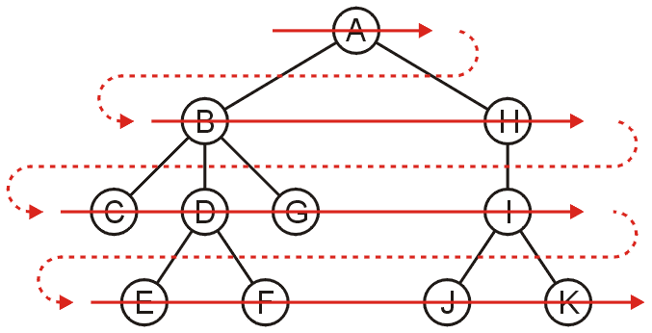
Breadth-First Traversal
Breadth-first traversal(BFT) visits all nodes level by level
Can be implemented using a queue
BFT Order in the following tree: A B H C D G I E F J K

Slide 41
Breadth-First Traversal
Visit each node starting from the highest level and move down level by level, from left to right.
(Other combinations such as rigtht to left, bottom to top are possible)
3
8
5
4
2
6
1
7
Breadth-first traversal result: 3 8 5 4 2 6 1 7
Notes:
41

Slide 42
Depth-First Tree Traversals
In Depth-First Tree Traversal, the deepest node is visited and then backtracks to its parent node if no sibling of that node exists.
An important point for this definition is that it does not specify exactly when nodes are visited. Based on this, we have three different variations of the depth-first traversal:
1. Preorder Traversal: root, left, right
2. Inorder Traversal: left, root, right
3. Postorder Traversal: left, right, root
Notes:
42

Slide 43
Depth-First Traversal: Preorder
In preorder tree traversal:
root is visited
the left subtree is traversed
the right tree is traversed
(Root-Left-Right )
3
8
5
4
2
6
1
7
Preorder tree traversal result: 3 8 4 7 2 5 6 1
Notes:
43

Slide 44
Iterative Traversals: PREORDER
Stacks are needed to store the nodes to be visited later.
Informal description:
1) Create an empty stack S and push root node to stack. 2) Do the following while S is not empty: a) Pop an item from stack and visit (process) it. b) Push right child of popped item to stack c) Push left child of popped item to stack
Right child is pushed before left child to make sure that left subtree is processed first.

Slide 45
iterativePreorder ( p ) // p: the root
{
Stack S
if ( p == NULL )
return
S . push ( p)
while ( ! S . isEmpty ( ) )
{
p = S . pop ( )
visit ( p )
if ( p−>right != NULL)
S . push ( p−>right ) ; // push right child for later visit
if ( p−>left != NULL )
S . push ( p−>left ) ; // push left child for later visit
}
}

Slide 46
Implementation of Iterative Preorder
struct node {
int data;
struct node* left;
struct node* right;
};
struct node* newNode(int data)
{
struct node* node = new struct node;
node->data = data;
node->left = NULL;
node->right = NULL;
return (node);
}
int main()
{
struct node* root = newNode(10);
root->left = newNode(8);
root->right = newNode(2);
root->left->left = newNode(3);
root->left->right = newNode(5);
root->right->left = newNode(2);
iterativePreorder(root);
return 0;
}
Notes:
46

Slide 47
Implementation of Iterative Preorder
void iterativePreorder(node* root)
{
if (root == NULL)
return;
stack<node*> nodeStack;
nodeStack.push(root);
while (nodeStack.empty() == false) {
struct node* node = nodeStack.top();
cout << node->data;
nodeStack.pop();
if (node->right)
nodeStack.push(node->right);
if (node->left)
nodeStack.push(node->left);
}
}
Notes:
47

Slide 48
Preorder Traversal with a Stack
Push the root onto the stack.
While the stack is not empty
pop the stack and visit it
push its two children
14
Stack
14
84
43
13
16
33
97
53
99
72
64

Slide 49
Preorder Traversal with a Stack
Push the root onto the stack.
While the stack is not empty
pop the stack and visit it
push its two children
84
43
14
Stack
14
14
84
43
13
16
33
97
53
99
72
64

Slide 50
Preorder Traversal with a Stack
Push the root onto the stack.
While the stack is not empty
pop the stack and visit it
push its two children
13
16
43
14 84
Stack
14
84
43
13
16
33
97
53
99
72
64

Slide 51
Preorder Traversal with a Stack
Push the root onto the stack.
While the stack is not empty
pop the stack and visit it
push its two children
53
16
43
14 84 13
Stack
14
84
43
13
16
33
97
13
53
99
72
64

Slide 52
Preorder Traversal with a Stack
Push the root onto the stack.
While the stack is not empty
pop the stack and visit it
push its two children
16
43
14 84 13 53
Stack
14
84
43
13
16
33
97
53
99
72
53
64

Slide 53
Preorder Traversal with a Stack
Push the root onto the stack.
While the stack is not empty
pop the stack and visit it
push its two children
99
72
43
14 84 13 53 16
Stack
14
84
43
16
13
6
33
97
53
99
72
64

Slide 54
Preorder Traversal with a Stack
Push the root onto the stack.
While the stack is not empty
pop the stack and visit it
push its two children
72
43
14 84 13 53 16 99
Stack
14
84
43
13
16
33
97
53
99
72
99
64

Slide 55
Preorder Traversal with a Stack
Push the root onto the stack.
While the stack is not empty
pop the stack and visit it
push its two children
43
14 84 13 53 16 99 72
Stack
14
84
43
13
16
33
97
72
53
99
72
64

Slide 56
Preorder Traversal with a Stack
Push the root onto the stack.
While the stack is not empty
pop the stack and visit it
push its two children
33
97
14 84 13 53 16 99 72 43
Stack
14
43
84
43
13
16
33
97
53
99
72
64

Slide 57
Preorder Traversal with a Stack
Push the root onto the stack.
While the stack is not empty
pop the stack and visit it
push its two children
64
97
14 84 13 53 16 99 72 43 33
Stack
14
84
43
16
33
13
33
97
53
99
72
64

Slide 58
Preorder Traversal with a Stack
Push the root onto the stack.
While the stack is not empty
pop the stack and visit it
push its two children
97
14 84 13 53 16 99 72 43 33 64
Stack
14
84
43
13
16
33
97
53
99
72
64
64

Slide 59
Preorder Traversal with a Stack
Push the root onto the stack.
While the stack is not empty
pop the stack and visit it
push its two children
14 84 13 53 16 99 72 43 33 64 97
Stack
14
84
43
16
33
97
13
97
53
99
72
64

Slide 60
Preorder Traversal with a Stack
Push the root onto the stack.
While the stack is not empty
pop the stack and visit it
push its two children
14 84 13 53 16 99 72 43 33 64 97
Stack
14
84
43
13
16
33
97
53
99
72
64

Slide 61
Depth-First Traversal: Postorder
In postorder tree traversal, the work at a node is performed after its children are evaluated.
(Left-Right-Root)
3
8
5
4
2
6
1
7
Postorder tree traversal result: 7 4 2 8 6 1 5 3
Notes:
61

Slide 62
Iterative Traversals: POSTORDER
Two stacks are needed.
Informal description:
1. Push root to first stack.
2. Loop while first stack is not empty
2.1 Pop a node from first stack and push it to second stack
2.2 Push left and right children of the popped node to first stack
3. Print contents of second stack

Slide 63
Postorder Traversal with a Stack
Push the root onto the first stack.
While the first stack is not empty
pop the first stack, push it to the second stack
push its two children to the first stack
14
14
84
43
Stack 1
Stack 2
13
16
33
97
53
99
72
64

Slide 64
Postorder Traversal with a Stack
Push the root onto the first stack.
While the first stack is not empty
pop the first stack, push it to the second stack
push its two children to the first stack
14
14
14
84
43
Stack 1
Stack 2
13
16
33
97
53
99
72
64

Slide 65
Postorder Traversal with a Stack
14
Push the root onto the first stack.
While the first stack is not empty
pop the first stack, push it to the second stack
push its two children to the first stack
43
84
14
14
84
43
Stack 1
Stack 2
13
16
33
97
53
99
72
64

Slide 66
Postorder Traversal with a Stack
43
14
Push the root onto the first stack.
While the first stack is not empty
pop the first stack, push it to the second stack
push its two children to the first stack
97
33
84
14
14
84
43
Stack 1
Stack 2
13
16
33
97
53
99
72
64

Slide 67
Postorder Traversal with a Stack
97
43
14
Push the root onto the first stack.
While the first stack is not empty
pop the first stack, push it to the second stack
push its two children to the first stack
33
84
14
14
84
43
Stack 1
Stack 2
13
16
33
97
53
99
72
64

Slide 68
Postorder Traversal with a Stack
33
97
43
14
Push the root onto the first stack.
While the first stack is not empty
pop the first stack, push it to the second stack
push its two children to the first stack
64
84
14
14
84
43
Stack 1
Stack 2
13
16
33
97
53
99
72
64

Slide 69
Postorder Traversal with a Stack
64
33
97
43
14
Push the root onto the first stack.
While the first stack is not empty
pop the first stack, push it to the second stack
push its two children to the first stack
84
14
14
84
43
Stack 1
Stack 2
13
16
33
97
53
99
72
64

Slide 70
Postorder Traversal with a Stack
84
64
33
97
43
14
Push the root onto the first stack.
While the first stack is not empty
pop the first stack, push it to the second stack
push its two children to the first stack
16
13
14
14
84
43
Stack 1
Stack 2
13
16
33
97
53
99
72
64

Slide 71
Postorder Traversal with a Stack
16
84
64
33
97
43
14
Push the root onto the first stack.
While the first stack is not empty
pop the first stack, push it to the second stack
push its two children to the first stack
72
99
13
14
14
84
43
Stack 1
Stack 2
13
16
33
97
53
99
72
64

Slide 72
Postorder Traversal with a Stack
72
16
84
64
33
97
43
14
Push the root onto the first stack.
While the first stack is not empty
pop the first stack, push it to the second stack
push its two children to the first stack
99
13
14
14
84
43
Stack 1
Stack 2
13
16
33
97
53
99
72
64

Slide 73
Postorder Traversal with a Stack
99
72
16
84
64
33
97
43
14
Push the root onto the first stack.
While the first stack is not empty
pop the first stack, push it to the second stack
push its two children to the first stack
13
14
14
84
43
Stack 1
Stack 2
13
16
33
97
53
99
72
64

Slide 74
Postorder Traversal with a Stack
13
99
72
16
84
64
33
97
43
14
Push the root onto the first stack.
While the first stack is not empty
pop the first stack, push it to the second stack
push its two children to the first stack
53
14
14
84
43
Stack 1
Stack 2
13
16
33
97
53
99
72
64

Slide 75
Postorder Traversal with a Stack
53
13
99
72
16
84
64
33
97
43
14
Push the root onto the first stack.
While the first stack is not empty
pop the first stack, push it to the second stack
push its two children to the first stack
14
14
84
43
Stack 1
Stack 2
13
16
33
97
53
99
72
64

Slide 76
Postorder Traversal with a Stack
53
13
99
72
16
84
64
33
97
43
14
Push the root onto the first stack.
While the first stack is not empty
pop the first stack, push it to the second stack
push its two children to the first stack
53 13 99 72 16 84 64 33 97 43 14
14
84
43
Stack 1
Stack 2
13
16
33
97
53
99
72
64

Slide 77
Depth-First Traversal: Inorder
In inorder tree traversal, we visit the left subtree of the current node first then the root and finally the right subtree:
(Left-Root-Right)
3
8
5
4
2
6
1
7
Inorder tree traversal result: 7 4 8 2 3 6 5 1
Notes:
77

Slide 78
Iterative Traversals: INORDER
Informal description:
Create an empty stack (say S).
Initialize the current node as root.
Push the current node to S and set current = current->left until current is NULL
If current is NULL and the stack is not empty then:
Pop the top item from the stack.
Print the popped item and set current = popped_item->right
Go to step 3.
If current is NULL and the stack is empty then we are done.

Slide 79
Recursive Preorder Traversal Algorithm
Since trees are recursive by definition, we can use recursion for most tree operations.
Let x be a node with children left[x] and right[x] and key[x] is the value of this node in a binary tree.
The pseudo code for recursive preorder traversal is very simple:
Access the tree using the root address
Display the content of the current node
Perform two recursive calls in preorder to left and right subtrees.

Slide 80
Recursive Pseudocode for Preorder Traversal
//Initially x is the root node
RPREORDER_TRAVERSAL(x)
if x ≠ NULL
display key[x] // Visit and process
RPREORDER_TRAVERSAL(left[x])
RPREORDER_TRAVERSAL(right[x])
How to call ?
Just supply the root address:
RPREORDER_Traversal(root[T])
Notes:
80

Slide 81
Recursive Pseudocode for Postorder Traversal
//The pseudo code of postorder traversal (Recursive):
//Initially x is the root
RPOSTORDER_TRAVERSAL(x)
if x ≠ NULL
RPOSTORDER_TRAVERSAL(left[x])
RPOSTRDER_TRAVERSAL(right[x])
display key[x]
Call can be done as in preorder:
RPOSTORDER_Traversal(root[T])
Notes:
81

Slide 82
Recursive Pseudocode for Inorder Traversal
//The pseuodo code of recursive inorder traversal :
// x is the root initially
RINORDER_TRAVERSAL(x)
if x ≠ NULL
RINORDER_TRAVERSAL(left[x])
display key[x]
RINORDER_TRAVERSAL(right[x])
Call : RINORDER_Traversal(root[T])
Notes:
82

Slide 83
Binary Search Trees
Hierarchical trees provide a very useful tool for search and sort operations.
What is the complexity of locating a data value in a linked list? → We have to scan the list until we find the value.
For example, if the list size is n=1.000.000, in the worst case we have to check the entire list until the end!
We have O(n) complexity which is too bad for search operations.
How to reduce this complexity ?
If the data is organized as a binary search tree, the cost of searching can be reduced substantially.
The nodes of a search tree are ordered in a specific way.
Notes:
83

Slide 84
Binary Search Trees: Definition
Values in each node of a binary search tree (BST) satisfy the following property:
If x represents a node in a BST and y is a node in the left subtree of x, then the value of y is less than or equal to the value of x.
If y is a node in the right subtree of x, then the value of y is greater than the value of x.
Binary search tree property: ∀ y in left subtree of x, key[y] ≤ key[x] and
∀ y in right subtree of x, key[y] > key[x].
In the examples, we will assume that each node stores a distinct integer item as the Key value → There are no duplicates in BST
Notes:
84

Slide 85
Binary Search Trees
7
7
3
9
3
9
1
5
8
10
1
8
5
10
4
4
A Binary Search Tree (BST)
A Binary Tree (but not a BST)
Notes:
85

Slide 86
Binary Search Trees
7
If we perform an inorder traversal on this BST the result will be
1 3 4 5 7 8 9 10
Which is a sorted sequence in increasing order.
3
9
1
5
8
10
4
Notes:
86

Slide 87
Searching for a Value in a BST
A common operation performed on a BST is searching for a given value of a node x.
To search for the value 4 in the tree we follow the path
7 → 3 → 5 → 4
What is the path length ?
7
3
9
1
5
8
10
4
Notes:
87

Slide 88
Why is the height h important?
Tree operations (e.g., insert, delete, search, retrieve etc.) are typically expressed in terms of the height h of the tree.
→h determines running time or complexity of most tree operations!

Slide 89
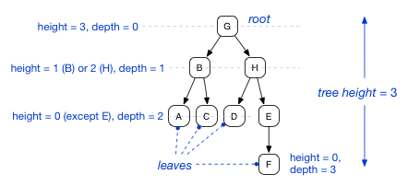
Reminder: Height and Depth
A full binary tree is a tree in which every node other than the leaves has two children.

Slide 90
Remainder: Node Counts in a Full Binary Tree of Height h
0
1
2
3
+1

Slide 91

The height and Complexity
In a full binary tree of height (Depth) h, total number of nodes is:
N = 1 + 2 + 4 + ... +2^{h}
= 2^{h+1} − 1 nodes
We can write this as :
$$2^{h+1}−1=N \\ ⇒2^{h+1}=N+1$$
$$⇒h+1=\log{(}N+1)$$
$$⇒h=\log{(}N+1)−1$$
$$⇒h=O(log{(}N+1))−O\left(1\right)$$
$$⇒O(\log{N})$$

Slide 92
The Height and Complexity of Tree Search
→Running time of full or complete tree search = h, which is determined by the height of the tree. This is the worst case.
Searching a value requires at most log₂ n comparisons.
EX: n=8 , log₂ 8 =3, n=16 ,log₂ 16 =4,……
The complexity of tree search is logarithmic time!

